Slide 1
FUKUSHIMA A timeline of tragedy

Slide 2
IN THE BEGINNING
Construction began: July 25, 1967
Consists of six boiling water reactors.
Came online between1970 and 1979
Combined power of 4.7 gigawatts - one of the 15 largest nuclear power stations in the world.
First nuclear plant to be designed, constructed, and operated in conjunction with General Electric and Tokyo Electric Power Company (TEPCO)
In 1990, the U.S. Nuclear Regulatory Commission (NRC) ranked the failure of the emergency electricity generators and subsequent failure of the cooling systems of plants in seismically very active regions one of the most likely risks. The Japanese Nuclear and Industrial Safety Agency (NISA) cited this report in 2004. According to Jun Tateno, a former NISA scientist, TEPCO did not react to these warnings and did not respond with any measures.

Slide 3
March 11, 2011 - Disaster strikes!!!
At 2:46 PM, a 9.0 magnitude earthquake strikes off Honshu island

Slide 4
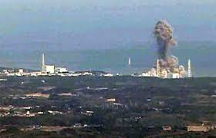
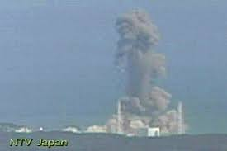
THE MELTDOWNS BEGIN
The earthquake and tsunami cut power to pumps that circulated coolant through the reactor cores and cooled water in the spent fuel pools, which led to the core meltdowns.
March 13 – 15: Explosions released large amounts of radioactive material into the air.
An estimated 18 quadrillion becquerels of cesium-137 released into the Pacific Ocean.
150 square miles of the ocean floor contaminated.

Slide 5
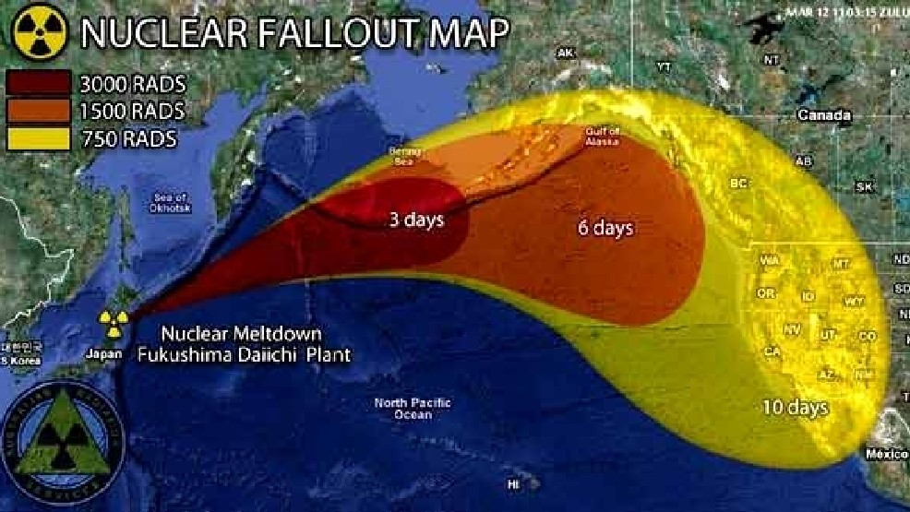
THE MELTDOWNS SPREAD RADIOACTIVE CONTAMINATION IN THE AIR, SOIL AND WATER

Slide 6
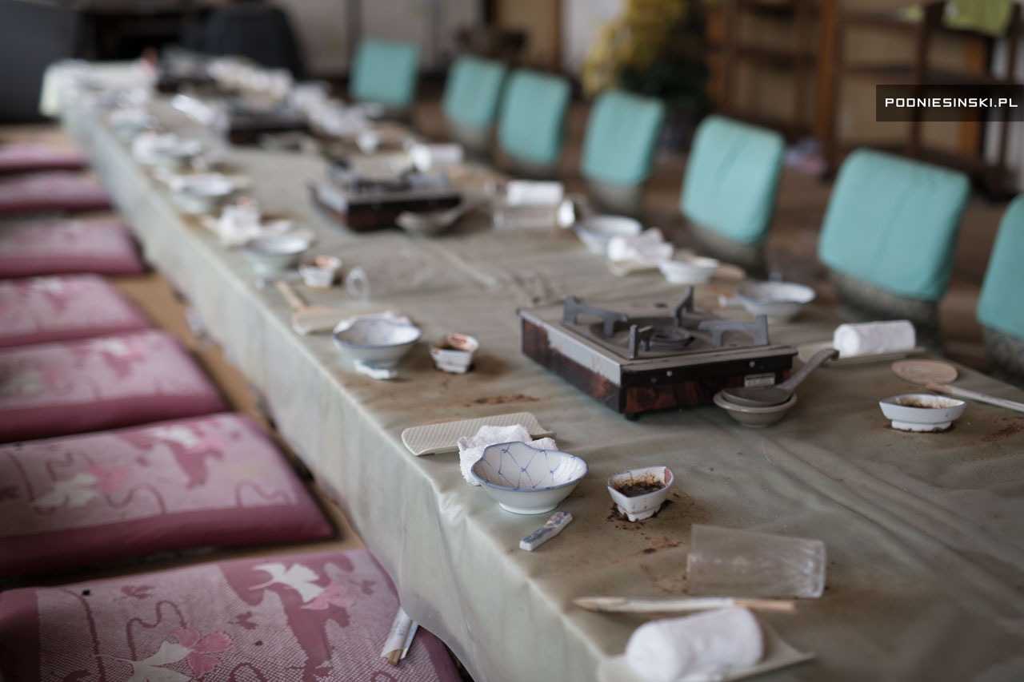
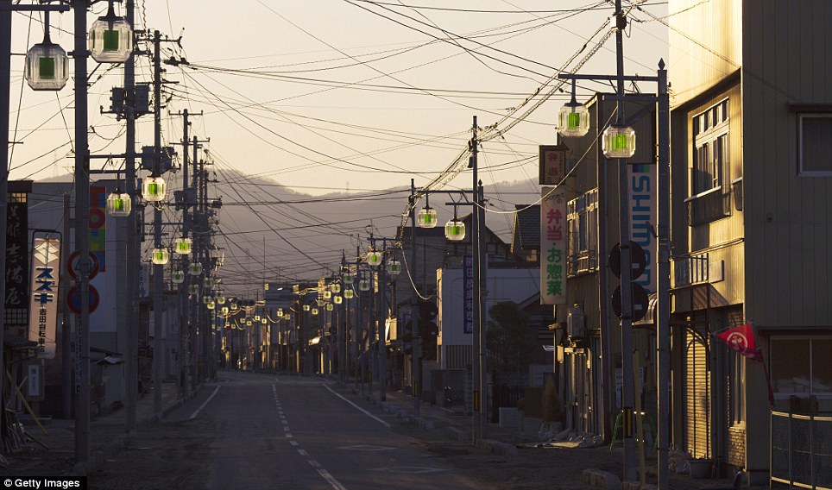
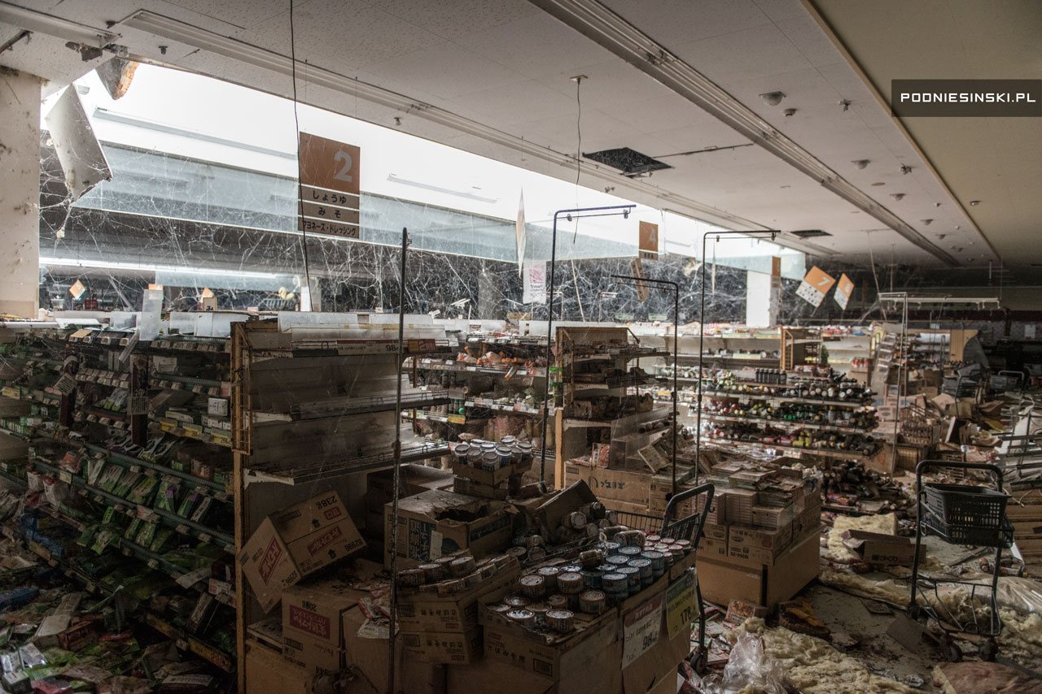
Radiation releases from Units 1– 4 forced the evacuation of about 165,000 residents.

Slide 7
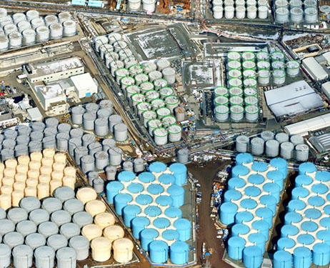
APRIL 2011 – RADIOACTIVE WATER LEAKING AND DUMPED INTO THE PACIFIC OCEAN
Levels of iodine-131 in seawater near the plant are measured to be 7.5 million times the legal limit.
Contaminated water continues to accumulate at the plant
Contaminated water from reactor 2 is found to be flowing into the sea.

Slide 8
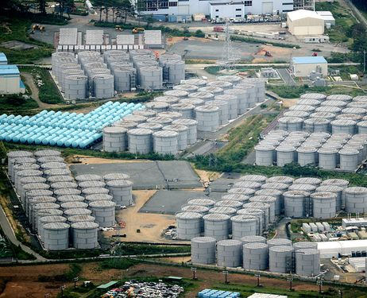
CONTAMINATED WATER CONTINUES TO FLOW INTO THE PACIFIC OCEAN
July - Radioactive cesium was 90 times higher and spread into the Pacific Ocean.
August - radioactive water leaking into the Pacific Ocean at a rate of 300 tons per day.
December - 230 tons of highly radioactive water are found in a tunnel beneath a building storing contaminated water.
Since the nuclear disaster, over 1.25 million tons of waste water has accumulated, stored in well over 1,000 tanks on on-site. It will run out of land for water tanks this year.

Slide 9
CONTINUING THE RADIOACTIVE CONTAMINATION OF THE PACIFIC OCEAN!
In 2020, the Japanese cabinet approved the dumping of radioactive water into the Pacific over a course of 30 years. They announced it will dump more than a million tons of contaminated wastewater into the Pacific Ocean, beginning in two years.
The contaminated water contains many radionuclides, which we know impact the environment and human health — including strontium-90.
Leaked internal TEPCO documents showing that efforts to reduce radionuclides to non-detectable levels have not eliminated numerous radioactive elements, including iodine, ruthenium, rhodium, antimony, tellurium, cobalt and strontium

Slide 10
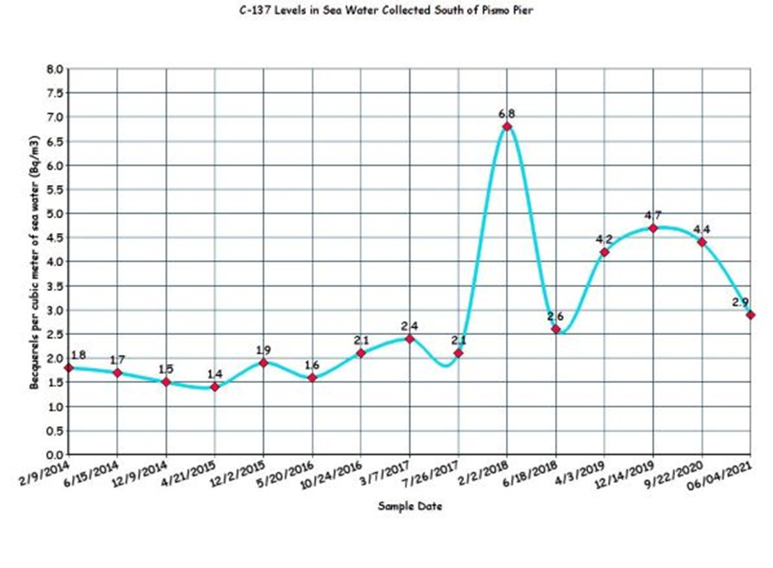
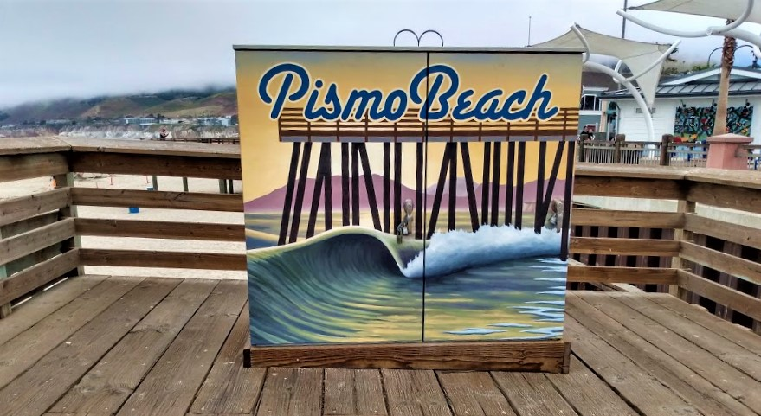
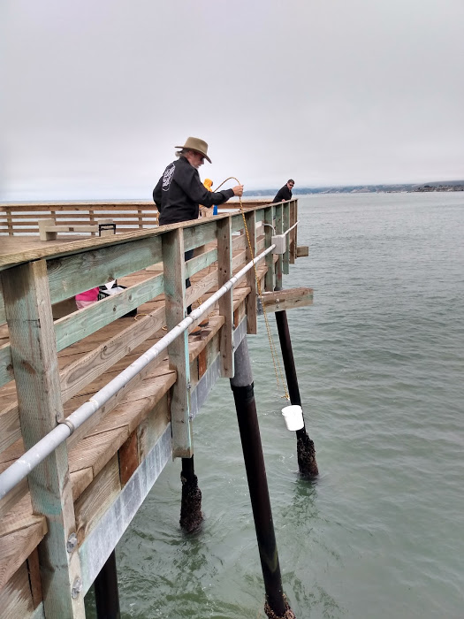
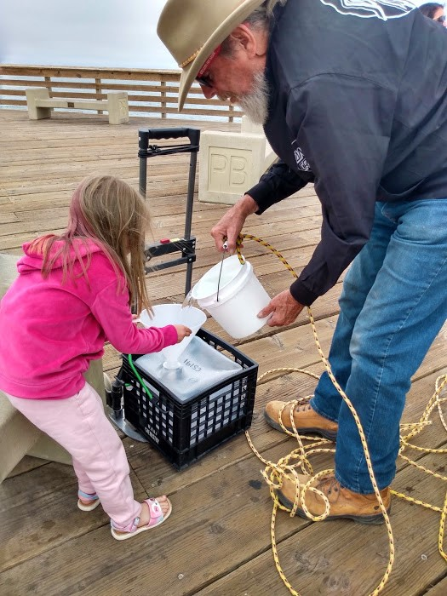
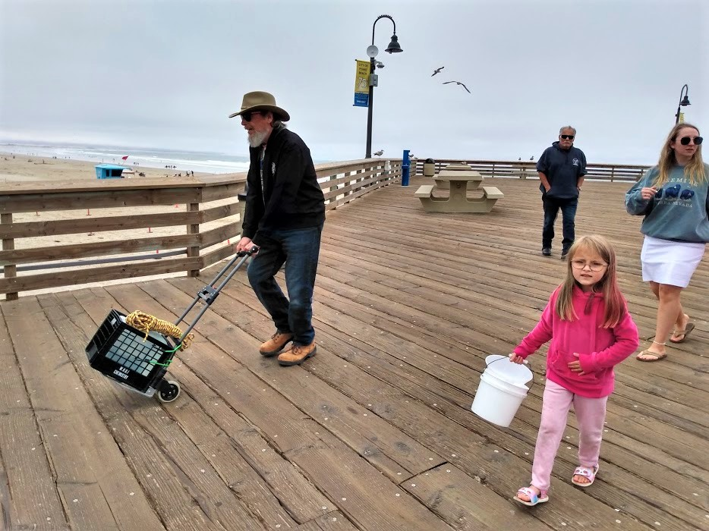
RADIOACTIVE TESTING OF PACIFIC OCEAN WATER FOR RADIOACTIVITY FROM FUKUSHIMA
2014 – In partnership with Woods Hole Oceanographic Institute Mothers for Peace begins sampling ocean water.
First tests show elevated levels of Cesium 137 showing radiation from Fukushima had reached California shores
2014 – 2017 – Cesium 137 levels went up and down
2018 – Cesium 137 spiked
2019 – 2021 – Cesium 137 levels rose and fell
2022 – Testing will continue

Slide 11
If you are interested in pursuing further action, Japanese government contacts are here:
Ministry of Economy, Trade & Industry (METI) (thru their website)
https://mm-enquete-cnt.meti.go.jp/form/pub/honsyo03/contact_us
TEPCO (through their website)
https://www4.tepco.co.jp/en/other/contact/general-e.html
Japanese Prime Minister & Cabinet (thru their website)
https://www.kantei.go.jp/foreign/forms/comment_ssl.html
https://www.facebook.com/Japan.PMO
Fukushima Prefectural Government
2-16 Sugitsuma-cho, Fukushima City, Fukushima 960-8670, Japan
Tel: +81-24-521-111
kouho@pref.fukushima.lg.jp
Liberal Democratic Party of Japan (ruling party)
1-11-23 Nagatacho, Chiyoda-ku, Tokyo 100-8910 Japan
Tel: +81-3-3581-6211
www.facebook.com/jimin.official

Slide 12
"311 Child Thyroid Cancer Trial"
On January 27, six men and women who suffered from thyroid cancer due to radiation exposure from the Fukushima Daiichi Nuclear Power Plant accident filed a lawsuit with the Tokyo District Court for damages by TEPCO.
The plaintiffs were 6 to 16 years old at the time of the accident (currently 17 to 27 years old). Four of the six have had their thyroid gland completely removed due to recurrence surgery and have to take hormones for the rest of their lives. This is the first class action lawsuit in which the public (other than nuclear power plant workers) sues the company for damages caused by radiation exposure from the nuclear accident.
We are looking for organizations and groups in Japan and overseas to support the 311 Children's Thyroid Cancer Trial. Please help us expand the circle of support for this trial in your community.
If you agree with us, please use the form below to enter your organization's information.
https://docs.google.com/forms/d/e/1FAIpQLSdzGq6zWDWjmF0SmQurGX1frbrGIktOQz-Hi0cyTv2DdzCKXg/viewform
Website: https://www.311support.net/

